Slide 1


Event sourcing on Azure functions code example

Slide 2



Open a new account
Each account number must be unique
Initial deposit amount (optional)
Beneficiary name (optional)
Notes:
Design / constraints
An account can only be created once - therefore if an event stream already exists for the account, do not create a new one or append an account opened event.

Slide 3

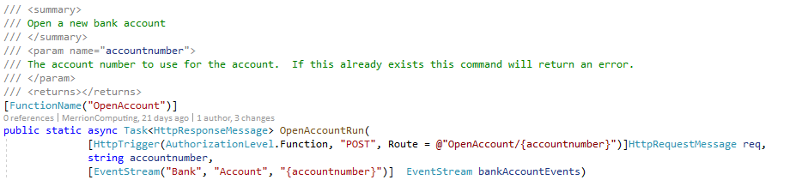
Open a new account
https://retailbankazurefunctionapp.azurewebsites.net/api/OpenAccount/A001B123456C
Notes:
When the serverless function is triggered the account number is taken from the URL and is used to instantiate a new eventstream variable for that bank account.

Slide 4
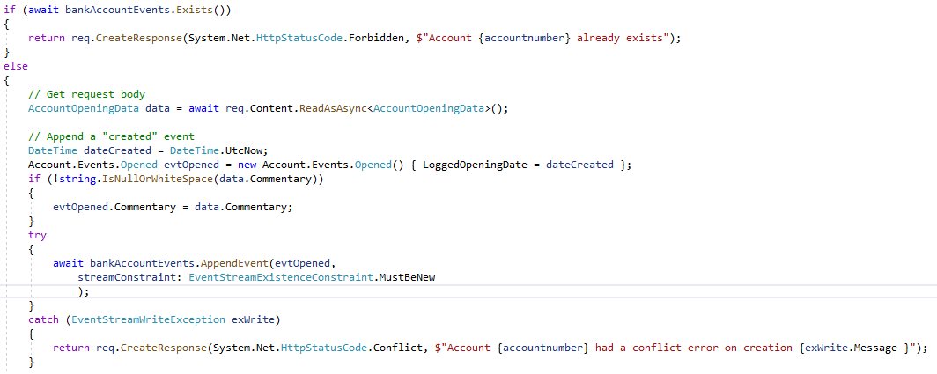
Open a new account
Notes:
Azure function

Slide 5
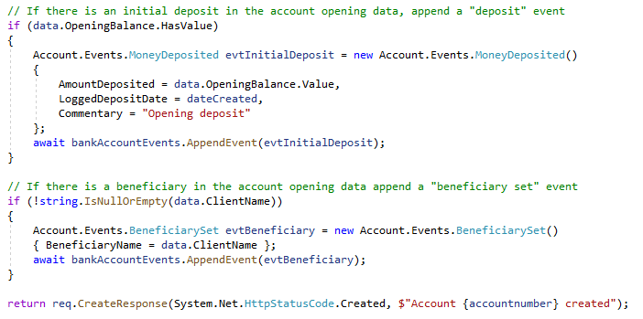
Open a new account
Notes:
The same command is able to append more than one event onto the event stream if that makes business sense

Slide 6

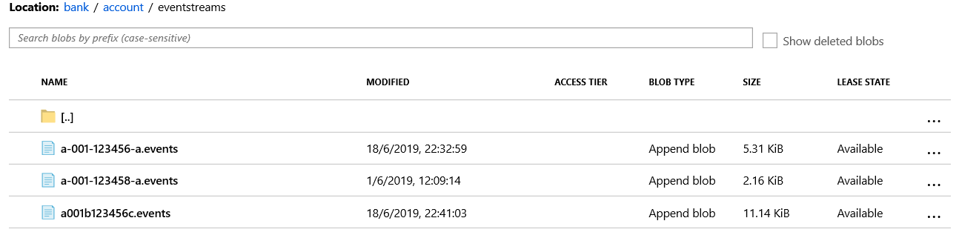
Open a new account
Notes:
The event stream created is stored in the Azure blob storage under a path made of Domain name -> Entity Type

Slide 7
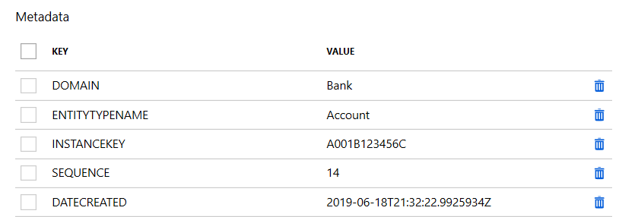
Open a new account
Notes:
Each blob also has metadata set for the properties of the event stream

Slide 8
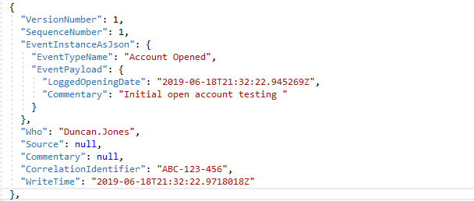
Open a new account
Notes:
The data for each event are in JSON and wrapped in the event context
(Projections only access the data inside the event instance but the outer wrapper is useful for debugging etc)

Slide 9
Make a deposit
Target account for the deposit must exist
Deposit amount
Source of the deposit (optional)
Notes:
Design / constraints
Depositing money is the simplest of all operations - we simply need to be sure that the account exists.

Slide 10
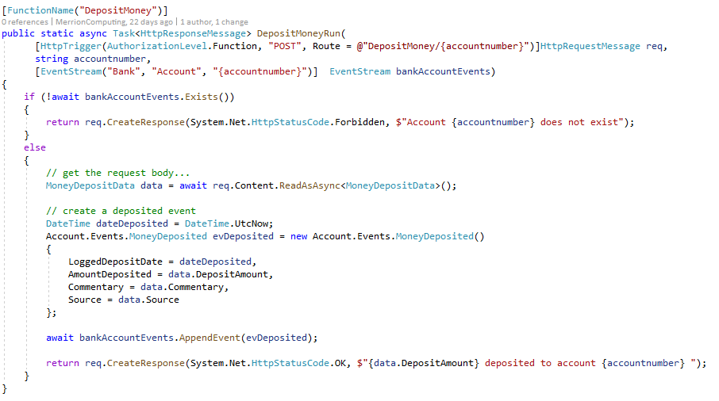
Make a deposit
Notes:
Azure function

Slide 11
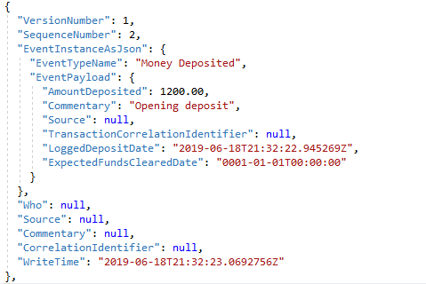
Make a deposit
Notes:
The deposit event is appended to the stream.
Importantly the state (current balance etc.) of the bank account is not stored in the event

Slide 12
Get the balance
The account number to get the balance from must exist
As of date (optional)
Notes:
Design / constraints
To get the balance of the account we need to run a projection over the bank account event stream which handles the money deposited event and the money withdrawn event to give the balance as at a given point.

Slide 13
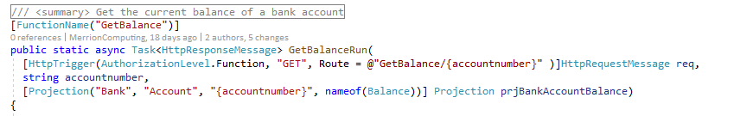
Get the balance
Notes:
Azure function

Slide 14
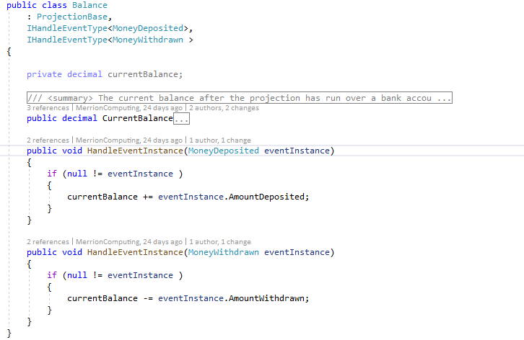
Balance projection
Notes:
Azure function

Slide 15
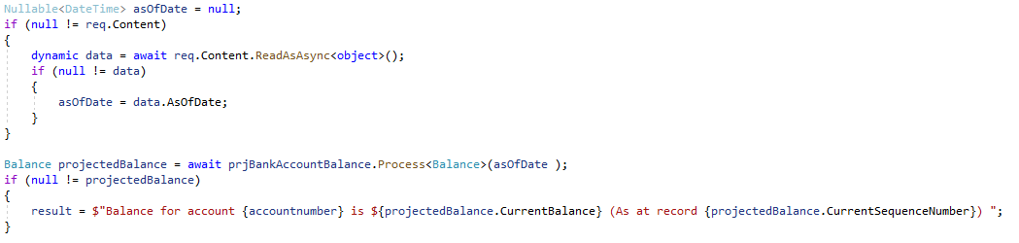
Get the balance
Notes:
The projection is run and when it has processed all the events in the event stream the value is returned.
1) Every projection also has a Current Sequence Number property that tells you the number of the last event in the stream that it read

Slide 16
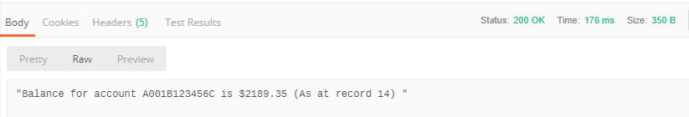
Get the balance
Notes:
Resulting event stream

Slide 17

Make a withdrawal
Target account number for the withdrawal must exist
Balance must be greater than or equal to the withdrawal amount
Concurrency crocodile!
Withdrawal amount
Notes:
Design / constraints
Withdrawing money requires running the balance projection to make sure that the account has the funds available to withdraw and only if it does, post the withdrawal event. When posting the withdrawal event we pass in the sequence number returned by the projection and if any other events have been written to the event stream since then an error is thrown and our withdrawal event is not appended.

Slide 18
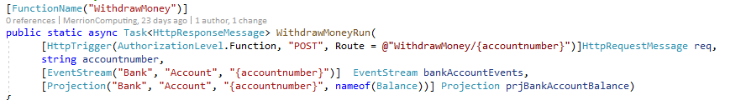
Make a withdrawal
Notes:
Azure function

Slide 19
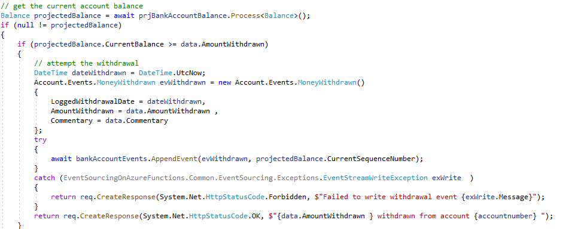
Make a withdrawal
Notes:
Azure function

Slide 20
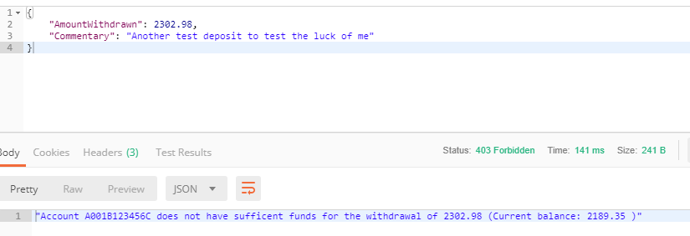
Make a withdrawal
Notes:
Resulting event stream

